Slide 1
Linked List

Slide 2







What is a Linked List?
Linked List is a form of a sequential collection and it does not have to be in order. A Linked list is made up of independent nodes that may contain any type of data and each node has a reference to the next node in the link.
Cars (nodes)
Head
Tail
Links
Each car is independent
Cars : passengers and links (nodes: data and links)

Slide 3







What is a Linked List?
Cars (nodes)
Head
Tail
Links
Head
001
1
111
2
222
4
333
5
null
Tail
001
111
222
333
Nodes : data and references

Slide 4
Linked List vs Array
Linked List =
Head
001
1
111
2
222
4
333
5
null
001
111
222
333
Tail
333
0 | 1 | 2 | 3 | 4 | 5
Array =
Elements of Linked list are independent objects
Variable size - the size of a linked list is not predefined
Random access - accessing an element is very efficient in arrays

Slide 5
Types of Linked List
Singly Linked List
Circular Singly Linked List
Doubly Linked List
Circular Doubly Linked List
Singly Linked List
Head
001
1
111
2
222
4
333
5
null
001
111
222
333
Tail
333
Circular Singly Linked List
Head
001
1
111
2
222
4
333
5
001
001
111
222
333
Tail
333

Slide 6
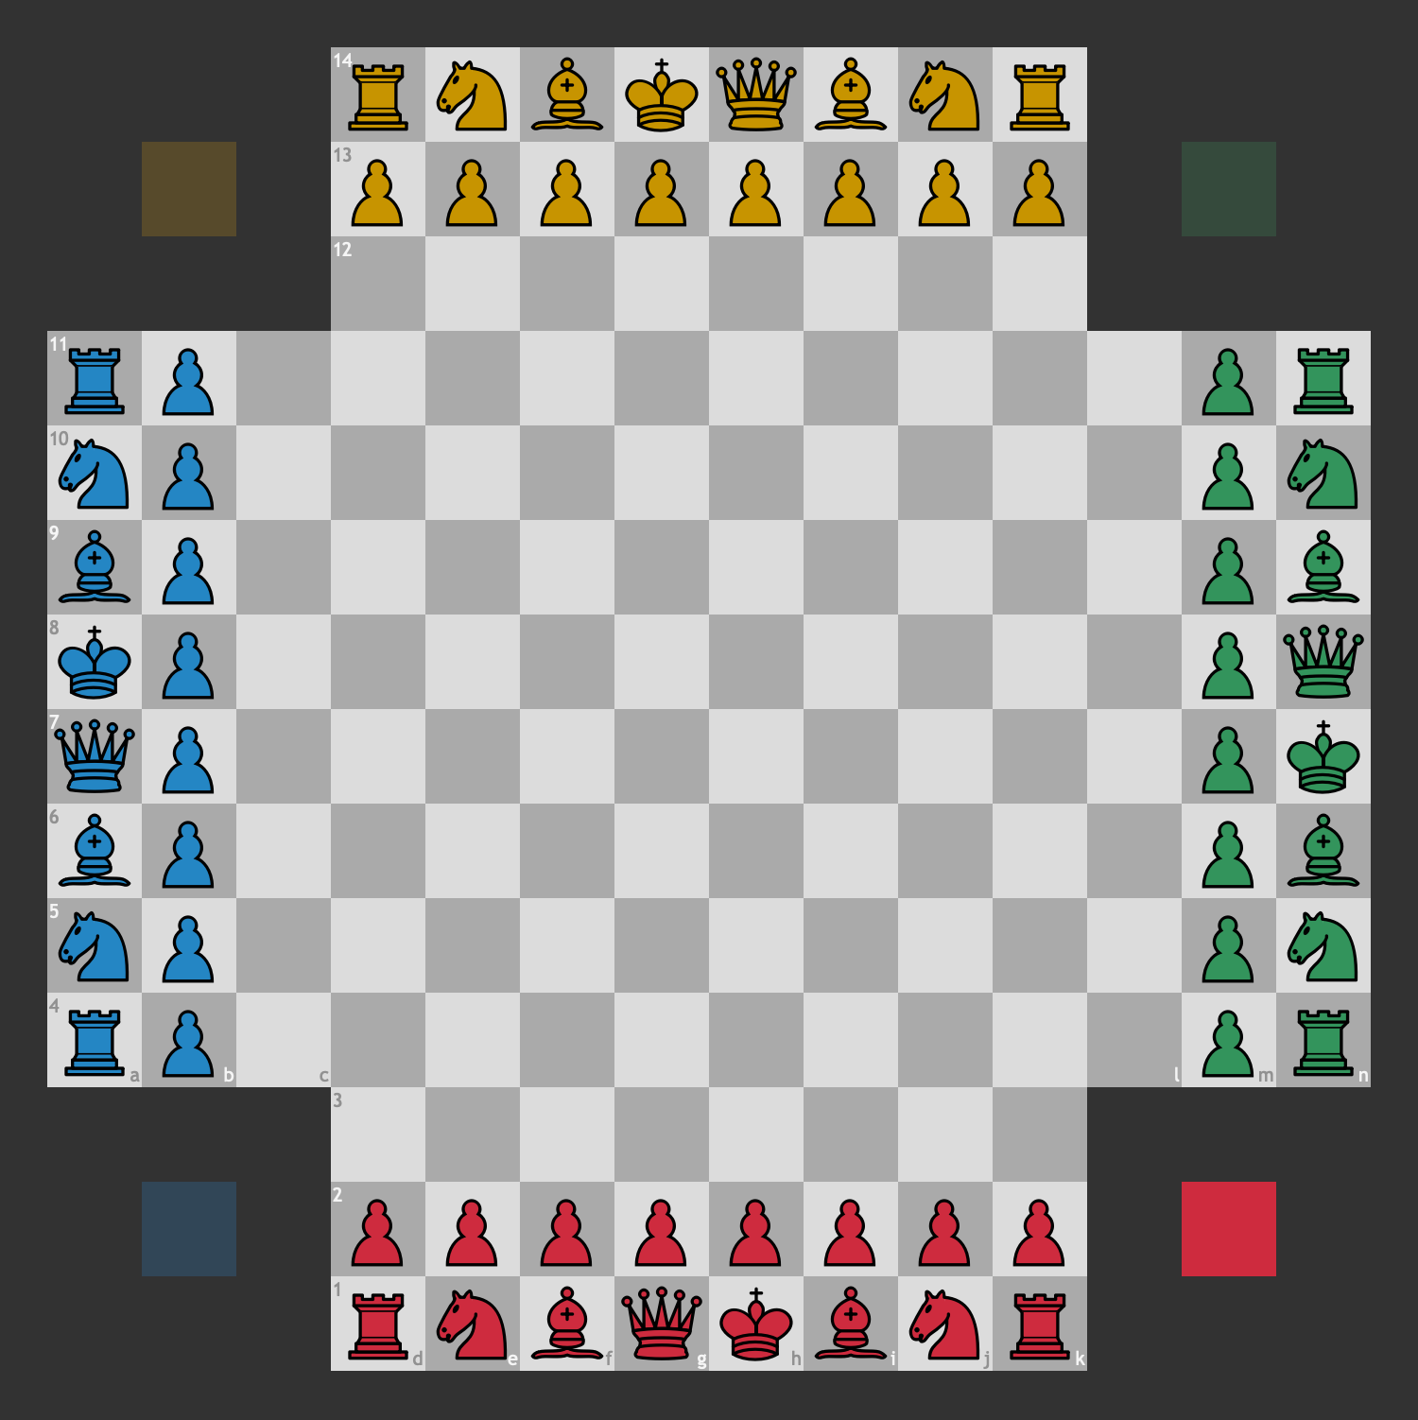
Types of Linked List
Circular Singly Linked List
Head
001
Player1
111
Player2
222
Player3
333
Player4 001
001
111
222
333
Tail
333

Slide 7
Types of Linked List
Doubly Linked List
Head
001
null
1
111
001
2
222
111
4
333
222 | 5 | null
001
111
222
333
Tail
333

Slide 8

Types of Linked List
Head
001
null | S1 | 111
001
S2
222
111
S3
333
222 | S4 | null
001
111
222
333
Tail
333

Slide 9
Types of Linked List
Circular Doubly Linked List
Head
001
333 | 1 | 111
001 | 2 | 222
111 | 4 | 333
222 | 5 | 001
001
111
222
333
Tail
333

Slide 10

Types of Linked List
Cmd+shift+tab
Head
001
333 | APP1 | 111
001 | APP2 | 222
111
APP3
333
222 | APP4 | 001
001
111
222
333
Tail
333

Slide 11
Linked List in Memory
Arrays in memory :
0 | 1 | 2 | 3 | 4 | 5
 |  | 0 | 1 | 2 | 3 | 4 | 5
Memory

Slide 12
Linked List in Memory
Linked list:
Head
1
1
111
2
222
4
333
5
null
2
Memory
4
Tail
5
1
Hea
d

Slide 13
Creation of Singly Linked List
Head
111
Create Head and Tail, initialize with null
Node
1
null
111
Tail
111
Create a blank Node and assign a value to it and reference to null.
Link Head and Tail with these Node

Slide 14
Creation of Singly Linked List
Create Head and Tail, initialize with null
O(1)
Create a blank Node and assign a value to it and reference to null.
O(1)
Link Head and Tail with these Node
O(1)

Slide 15
Insertion to Linked List in Memory
At the beginning of the linked list.
After a node in the middle of linked list
At the end of the linked list.

Slide 16

Insertion to Linked List in Memory
Insert a new node at the beginning
0
Head
1
1
111
2
222
4
333
5
null
2
0
Memory
4
5
1
Head

Slide 17
Insertion to Linked List in Memory
Insert a new node after a node
3
Head
1
1
111
2
222
4
333
5
null
2
0
Memory
Head
4
5
1
3

Slide 18
Insertion to Linked List in Memory
Insert a new node at the end of linked list
3
Head
1
1
111
2
222
4
333
5
null
3
2
0
Memory
Head
4
5
1

Slide 19
Insertion Algorithm
Node value Location
-
create node assign value
No
-
head=None?
Yes
-
-
head = node tail = node
-
node.next = head head = node
Yes
-
Location = first
No
-
-
-
node.next = null last.next = node tail = node
Yes
Terminate
Location = last
-
-
-
Find location (loop) current.next = node node.next =nextNode
No

Slide 20

Insertion Algorithm
Node value Location
-
-
create node assign value
No
head=None?
-
-
Yes
head = node tail = node
-
Yes
-
node.next = head head = node
Location = first
No
-
-
-
node.next = null last.next = node tail = node
Yes
Terminate
Location = last
-
-
-
Find location (loop) current.next = node node.next =nextNode
No
AppMillers

Slide 21

Singly Linked List Insertion at the beginning
Head
444
1
111
2
222
4
333
5
null
Tail
001001
001
111
222
333
- node.next = head
6
- head = node
444

Slide 22

Singly Linked List Insertion at the end
Head
001
1
111
2
222
4
333
5
444
Tail
null
001
111
222
333
- node.next = null
- last.next = node
6
null
- tail = node
444

Slide 23

Singly Linked List Insertion in the middle
Head
001
1
111
2
222
4
444
5
null
Tail
333
001
111
222
333
- find location (loop)
- current.next = node
6
333
- node.next =nextNode
444

Slide 24
Traversal of Singly Linked List
Head
001
1
111
2
222
4
333
5
null
Yes
- Loop all nodes
Start
Check Head?
- Print value
No
Terminate

Slide 25
Search in Singly Linked List
Head
001
1
111
2
222
4
333
5
null
No
Start
Check Head?
Yes
nodeValue
If nodeValue=currentNode
No
Yes
Terminate

Slide 26

Singly Linked list Deletion
Deleting the first node
Deleting any given node
Deleting the last node
Case 1 - one node
Head
null
1
null
001
001
Tail
null
001

Slide 27
Singly Linked list Deletion
Deleting the first node
Deleting any given node
Deleting the last node
Case 2 - more than one node
Head
111
1
111
2
222
4
333
5
null
001
001
111
222
333
Tail |  | 333

Slide 28


Singly Linked list Deletion
Deleting the first node
Deleting any given node
Deleting the last node
Head
001
1
111
2
333
4
333
5
null
222
001
111
222
333
Tail
333

Slide 29
Singly Linked list Deletion
Deleting the first node
Deleting any given node
Deleting the last node
Case 1 - one node
Head
null
1
null
001
001
Tail
null
001

Slide 30

Singly Linked list Deletion
Deleting the first node
Deleting any given node
Deleting the last node
Case 2 - more than one node
Head
001
1
111
2
222
4
null
5
null
333
001
111
222
333
Tail
222
333

Slide 31
Singly Linked list Deletion Algorithm
No
Location
head=None?
Yes
-
-
head = null tail = null
Yes
Location = first
-
head = first.next
No
-
-
head = null tail = null
-
-
-
Yes
Terminate
Find node before last node (loop)
beforeLast.next = null tail = beforeLast
Location = last
No
-
-
find location (loop) current.next = nextNode.next

Slide 32

Delete entire Singly Linked List
Head
null
1
111
2
222
4
333
5
null
001
001
111
222
333
Tail
null
333

Slide 33
Time and Space Complexity of Singly Linked List
Singly Linked List | Time complexity | Space complexity
Creation | O(1) | O(1)
Insertion | O(n) | O(1)
Searching | O(n) | O(1)
Traversing | O(n) | O(1)
Deletion of a node | O(n) | O(1)
Deletion of linked list | O(1) | O(1)
Head
001
1
111
2
222
4
333
5
null
001
111
222
333
Tail
333

